Slide 1
How Child Care in Rural Areas Can Unlock Economic Potential
A Joint Project of BPC and Save the Children
November 1, 2023
Notes:
In rural America, families experience challenges accessing and affording child care that exceed those of urban areas. Discuss how the roundtable discussion informed the framework document, Highlight stakeholders who attended roundtable, co-created framework articulates the challenges, strategies, and solutions that are critical to the development of child care policies in rural regions.

Slide 2
Overview
Background
The Problem
Innovative Solutions
Policy Recommendations
Notes:
Gaps in child care supply and the economic impact of those gaps are larger in rural America than in urban areas.
More than 40% of the population lives in rural areas in each of the following 10 states, listed from highest to lowest:
Vermont
Maine
West Virginia
Mississippi
Montana
Arkansas
South Dakota
Alabama
New Hampshire
Kentucky
More than 2 million people live in rural areas in each of the following 11 states:
Texas
North Carolina
Pennsylvania
Ohio
Georgia
Michigan
New York
Tennessee
California
Alabama
Virginia
The nationwide child care gap in urban areas is 28.9%, versus 35.1% in rural areas.
Beyond the existence of the gap, the economic implications of parents unable to enter the workforce extends to households, businesses, and tax revenues. States with the largest rural child care gaps face the greatest economic consequences, with costs in the rural areas studied by BPC ranging from $33 billion to $50 billion.

Slide 3
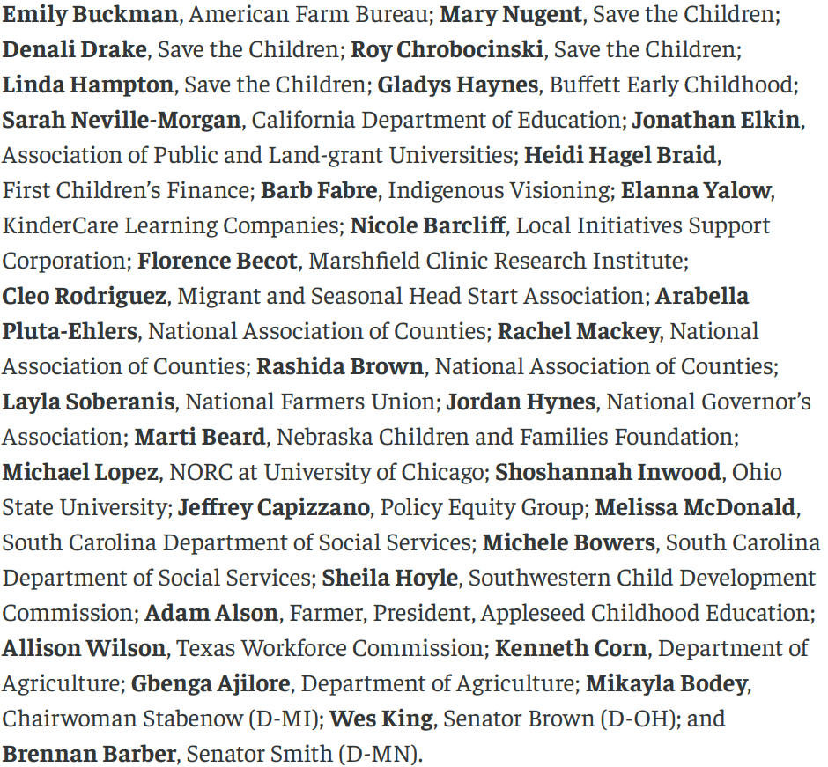
Rural Child Care Roundtable Participants

Slide 4
Rural Child Care Landscape: Child Care Gap & Economic Impact
Child Care Gap
Rural | 35.1%
Urban | 28.9%
National | 31.2%
Economic Impact
Rural Projected Economic Loss | $33 billion to $50 billion annually
National Projected Economic Loss | $142 billion to $217 billion annually
Data from Child Care in 35 States: What we know and don’t know
Notes:
Gaps in child care supply and the economic impact of those gaps are larger in rural America than in urban areas.
More than 40% of the population lives in rural areas in each of the following 10 states, listed from highest to lowest:
Vermont
Maine
West Virginia
Mississippi
Montana
Arkansas
South Dakota
Alabama
New Hampshire
Kentucky
More than 2 million people live in rural areas in each of the following 11 states:
Texas
North Carolina
Pennsylvania
Ohio
Georgia
Michigan
New York
Tennessee
California
Alabama
Virginia
The nationwide child care gap in urban areas is 28.9%, versus 35.1% in rural areas.
Beyond the existence of the gap, the economic implications of parents unable to enter the workforce extends to households, businesses, and tax revenues. States with the largest rural child care gaps face the greatest economic consequences, with costs in the rural areas studied by BPC ranging from $33 billion to $50 billion.

Slide 5
Rural Child Care: By the Numbers
In towns with 500 residents or fewer,
51% have access to a child care center
34% have access to a family child care home
In towns with 501 to 2,500 residents,
70% have access to a child care center
40% have access to a family child care home
33
20%
25%
26%
69%
Number of children that are seriously injured every day in ag-related incidents
Of rural population is 65 years and older
Need care during non-traditional hours
Families with access to care within 5 miles of home
One or more parents working on-site
97%
62%
48%
86%
<$200
Farm families are concerned that their children could get hurt on the farm
Farm families report access to affordable care as an important strategy for keeping children safe
Farm families report access to care is important to the viability of their farm
Rural parents or their partner not currently working due to lack of child care
Amount most parents report they can pay for care per week

Slide 6
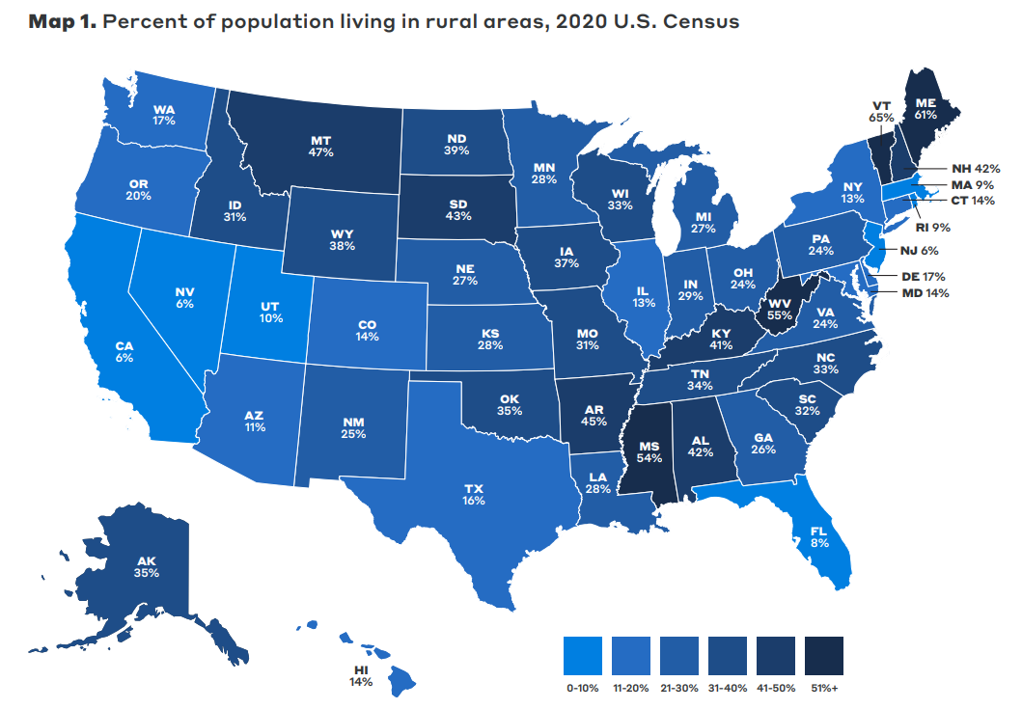
Rural vs. Urban Child Care
Families travel longer distances
Workforce shortages felt more acutely
Disproportionate access to resources
Increased administrative burdens
Notes:
Residents travel longer distances to access services and resources than in cities and suburbs, affecting families’ access to child care programs and parents’ ability to remain in the workforce. The rural child care workforce has less access to resources, including professional development and higher education. Rural areas feel the child care workforce shortages more acutely than urban areas, making it even harder to sustain programs and maintain quality. Rural challenges are felt by every stakeholder in the child care system, from families of young children to state administrators. Family child care programs have less access to capital as self-employed, for-profit entities. Many loans and grants are available only for nonprofits. Geographically large states with small populations have additional administrative burdens because of added travel time. For agency staff, it costs more to perform licensing inspections, provide coaching and technical assistance observations, and implement professional development trainings.

Slide 7
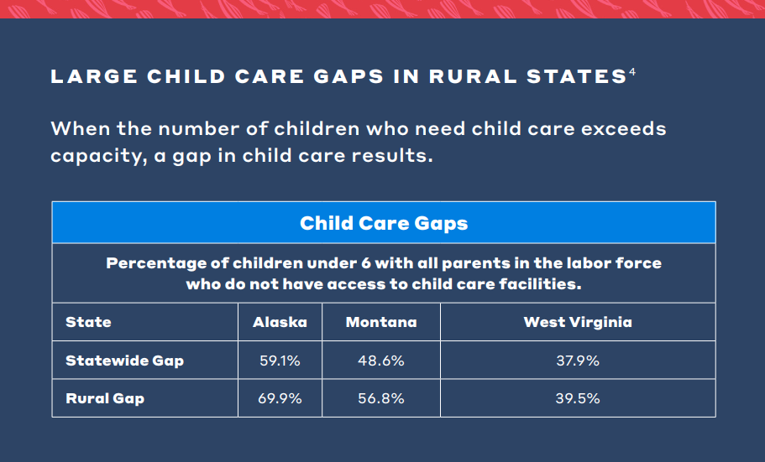
Notes:
Residents travel longer distances to access services and resources than in cities and suburbs, affecting families’ access to child care programs and parents’ ability to remain in the workforce. The rural child care workforce has less access to resources, including professional development and higher education. Rural areas feel the child care workforce shortages more acutely than urban areas, making it even harder to sustain programs and maintain quality. Rural challenges are felt by every stakeholder in the child care system, from families of young children to state administrators. Family child care programs have less access to capital as self-employed, for-profit entities. Many loans and grants are available only for nonprofits. Geographically large states with small populations have additional administrative burdens because of added travel time. For agency staff, it costs more to perform licensing inspections, provide coaching and technical assistance observations, and implement professional development trainings.

Slide 8
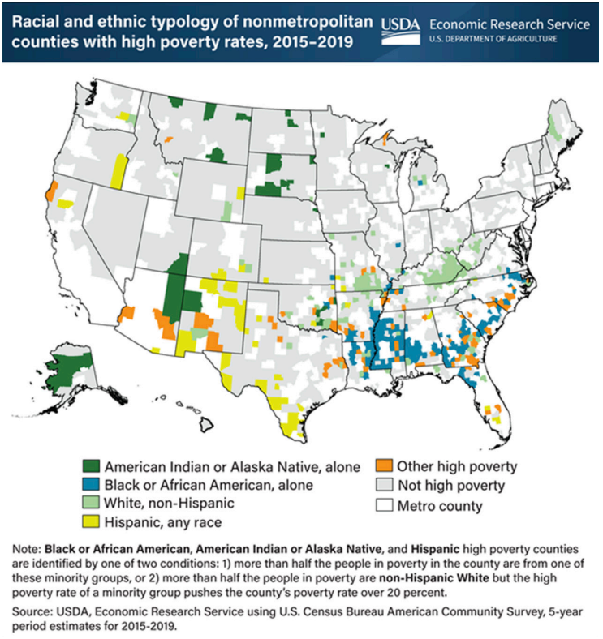
The Problem:
Affordability and Financing
Lack of economies of scale
Child care business model
Limited access to capital
Lack of dedicated infrastructure funding
Notes:
Many rural counties have high and persistent levels of poverty. Where poverty is highest, families struggle the most to afford child care for their children. Of parents surveyed in rural areas who considered a licensed program but instead relied on parental or relative provided child care, more than half said that cost influenced their decision not to use a child care program. Operators of child care programs also face affordability challenges. Child care directors need funding to open their programs and to withstand enrollment fluctuations; they also need adequate revenue to maintain facilities and equipment. Private capital, investors, and existing child care business owners are less likely to expand in rural areas where smaller populations and spread-out resources add additional challenges. Federal, state, and local funds are less accessible in rural areas, which often lack coordinated regional services. As a result, child care programs struggle to access financing.

Slide 9
Innovative Solutions:
Building Supply
Facilities Development
Increase dedicated funding for:
New construction
Renovation
Maintenance
State Initiatives
Arkansas Act 131
Colorado Employer-Based Child Care Facility Grant
Iowa Child Care Challenge Fund
Illinois Early Childhood Construction Grant (ECCG) Program
Notes:
State administrators can incorporate flexible policies and career pathways that are responsive to workforce shortages, workforce turnover, and the lack of access to training, credentials, and higher education in many areas. States can offer multiple career pathways as part of workforce development strategies for child care that take rural challenges into account. To increase access to child care and early learning, states and communities need to support the construction, renovation, and maintenance of facilities in ways that are responsive to rural contexts. This support could include partnerships with employers, school districts, and other local community partners.

Slide 10
Innovative Solutions:
Building Supply
Workforce Development
Flexible career pathways responsive to:
Workforce shortages
Turnover
Limited access to professional development
State Initiatives
Alabama Early Childhood Educator Apprenticeship Program
Kentucky Early Childhood Workforce Development Plan
Wisconsin Early Childhood Educator Apprenticeship Program
Notes:
State administrators can incorporate flexible policies and career pathways that are responsive to workforce shortages, workforce turnover, and the lack of access to training, credentials, and higher education in many areas. States can offer multiple career pathways as part of workforce development strategies for child care that take rural challenges into account. To increase access to child care and early learning, states and communities need to support the construction, renovation, and maintenance of facilities in ways that are responsive to rural contexts. This support could include partnerships with employers, school districts, and other local community partners.

Slide 11
A Shared Responsibility:
Coordination & Collaboration
Local & State Chambers of Commerce
Child Care Resource & Referral
Cooperative Extensions
USDA Rural Partners Network
Community Development Financial Institutions (CDFIs)
State Economic Development Boards
Early Head Start-Child Care Partnerships
Notes:
Developing and operating child care should be a shared responsibility between parents, providers businesses, philanthropy, and the public. Federal and state investments should be responsive to the distances traveled in rural areas and plan for those increased costs in their budgets and appropriations. Regional coordination through intermediaries helps mitigate the challenges by helping child care program administrators, teachers, and staff access funding, technical assistance, and resources. Local businesses, nonprofits, and philanthropy can and should be important partners investing in community child care initiatives.

Slide 12
Policy Recommendations:
Reduce Barriers and Increase Investment
Local, County, & Municipal
Business, Nonprofit, & Philanthropic
State
Federal
Review and revise local ordinances operating as barriers to care
Help develop regional early learning hubs
Conducts a needs assessment
Identify resources to expand supply
Support regional hub models
Increase funding for administrative costs
Expand access to capital
Increase CCDBG administrative cap
Remove barriers to home-based care
Partner with local leaders and stakeholders to conduct a needs assessment
Help identify investments

Slide 13
Signatories
A Place to Grow Daycare Center and Preschool
Alianza Nacional de Campesinas, Inc.
Appleseed Childhood Education, Inc.
Buffet Early Childhood Fund
California Department of Education
Children's Environmental Health Network
Children's Institute - Oregon
Child Care Aware of America
Colorado Children's Campaign
Community Foundation DeKalb County
Community Foundation of Pulaski County, Inc.
Community Foundation of Wabash County
Early Childhood Coalition of Huntington County
First Children's Finance
First Five Years Fund
Graduate Center for the Study of Early Learning, University of Mississippi
Groundwork Ohio
Hawaii Children's Action Network
Idaho Association for the Education of Young Children
IMD Early Learning
Indigenous Visioning/All Nations Rise
KinderCare Learning Companies
Local Initiatives Support Corporation (LISC)
Louisiana Partnership for Children and Families
Magic Valley Early Learning Collaborative
Maine Association for the Education of Young Children
Marshfield Clinic Health System
Mom Congress
MSD of Steuben County Early Learning Center
National Association for Family Child Care
National Association of Counties (NACo)
National Children's Facilities Network (NCFN)
Northeast Indiana Early Childhood Coalition
Pulaski Alliance for Community Education (PACE)
Riverence Holdings LLC
Southwestern Child Development Commission
The Policy Center for Maternal Mental Health
TLC for Tots
Warrior Up Kids Club, Winamac 1st United Methodist Church
West Central School Corporation
@BPC_Bipartisan
linkedin.com/company/ bipartisan-policy-center/
@BipartisanPolicyCenter

